Slide 1
SharePoint Framework (SPFx)
Learning Session
Arturo De la Garza | SharePoint Consultant @Definity First

Slide 2
What is SPFx ?
SPFx is a new development model for building Client Web Parts for the new Modern Sites Pages.
SPFx solutions consist 100% of JavaScript. You can use any browser framework that you like – React, Handlebars, knockout, angular – take your pick.
SPFx runs in the context of the current user. There is no permission elevation like you could do with farm solutions or app-only context in CSOM.
The development tool chain is based on common open source client tools like Node.js, npm, TypeScript, yeoman, gulp.

Slide 3
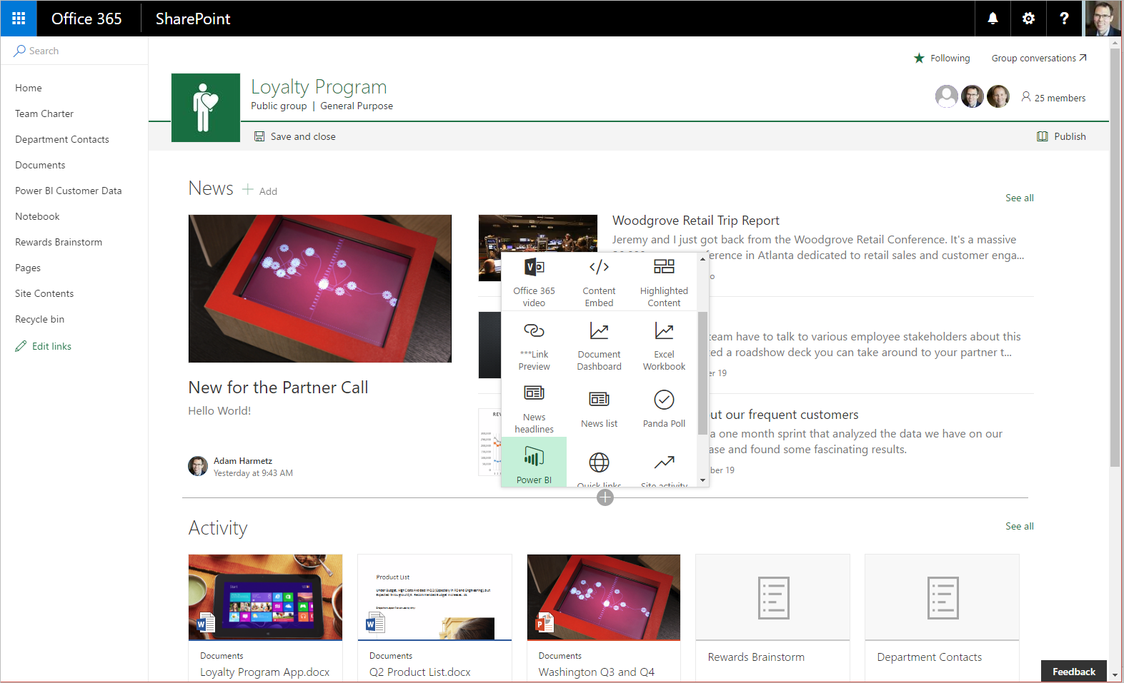
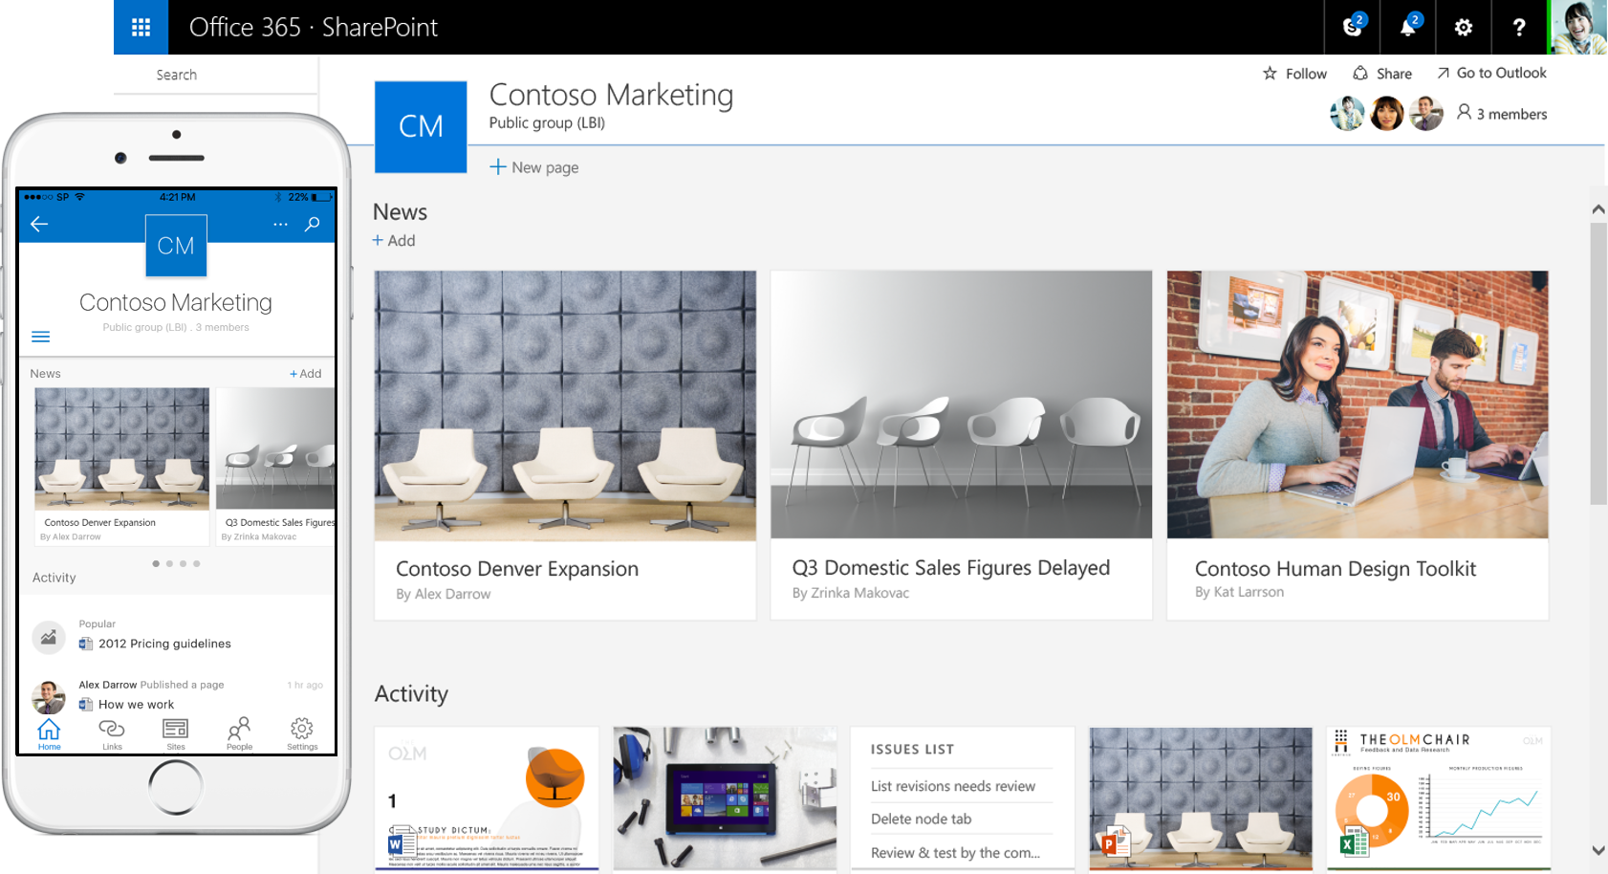
Modern Site Pages
http://blog.vitalyzhukov.ru/en/pros-and-cons-of-sharepoint-new-experience.aspx

Slide 4
Important Notes
The code of SPFx solutions can be hosted anywhere you want (e.g. a CDN, or a website you host)
Solutions built using SPFx can be used both on modern team sites as well as on existing sites using the classic SharePoint experience.
SharePoint Add-Ins are still fully supported. SPFx does NOT replace ANY of the previous development models for SharePoint.
SharePoint Framework Components
Client Side Webparts
SharePoint Webhooks – these are the new “event receivers”
SPFx is still on developer preview phase:
Latest package Release Candidate 0 – Get latest SP package “npm i -g @microsoft/generator-sharepoint@latest”

Slide 5
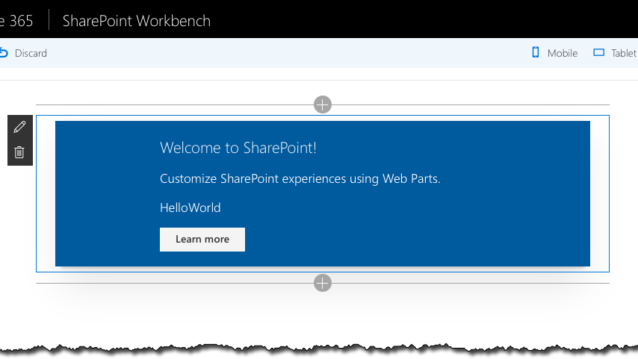
Client Side Web parts

Slide 6
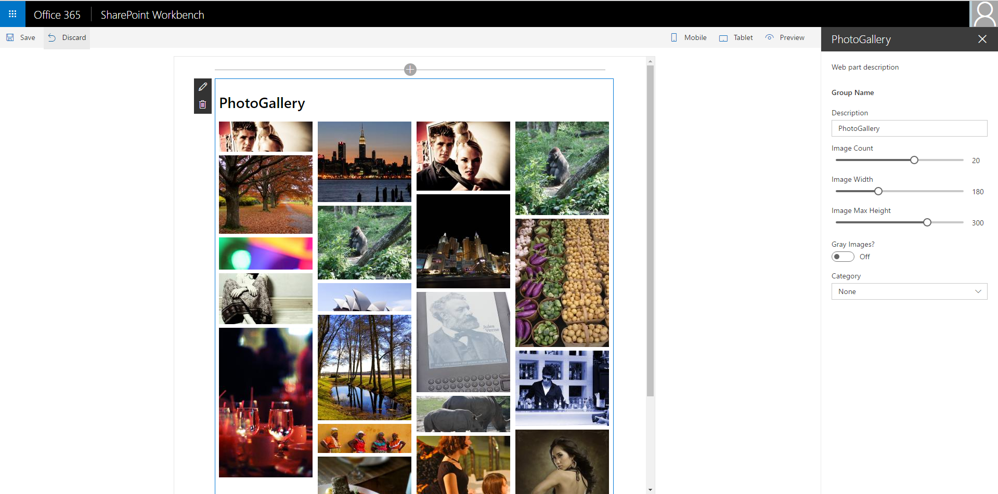
Web part example

Slide 7
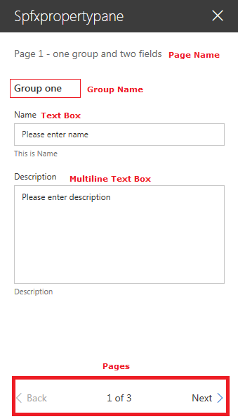
Property Pane
The following field types are supported:
Label
Textbox
Multi-line Textbox
Checkbox
Dropdown
Link
Slider
Toggle
Custom
The property pane has three key metadata:
Pages
Header
Groups
Property | Description
errorMessage | A static value for the error message
onGetErrorMessage | Pointer to function to use for validation
deferredValidationTime | Amount of time (milliseconds) to wait before showing the validation error message

Slide 8
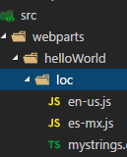
Location Strings
Location files are in JSON format
They work similar as Resources files (XML) on VS Solution
The default language is English (en-us)
Developers can test the locale by:
Updating write-manifests.json file
{ "cdnBasePath": "<!-- PATH TO CDN -->", "debugLocale": “es-mx" }
Or by using the “locale” command argument
gulp serve --locale=es-mx
Note: the documentation of this feature is still in progress.

Slide 9
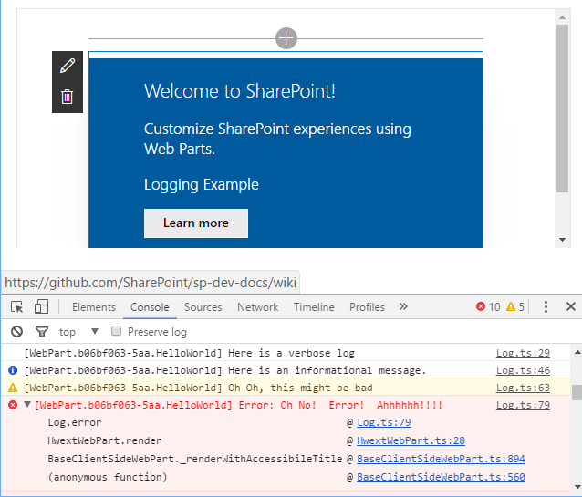
Logging API
The SharePoint Framework contains a logging API that can be used to log messages during the lifecycle of your webpart. The API documentation is here - https://sharepoint.github.io/classes/_sp_client_base_.log.html
The logging levels are fairly standard, with Verbose being the least important, followed by Info, Warning and Error.
Here is how you go about using it.
Reference the Log class:
import{ Log } from '@microsoft/sp-core-library';
Log your message from your WebPart:
Log.verbose("HelloWorld", "Here is a verbose log", this.context.serviceScope);
Log.info("HelloWorld", "Here is an informational message.", this.context.serviceScope);
Log.warn("HelloWorld", "Oh Oh, this might be bad", this.context.serviceScope);
Log.error("HelloWorld", new Error("Oh No! Error! Ahhhhhh!!!!"), this.context.serviceScope);
This will result in the following in the debug console
MS will be adding features around logging in the future.

Slide 10
Development Environment

Slide 11
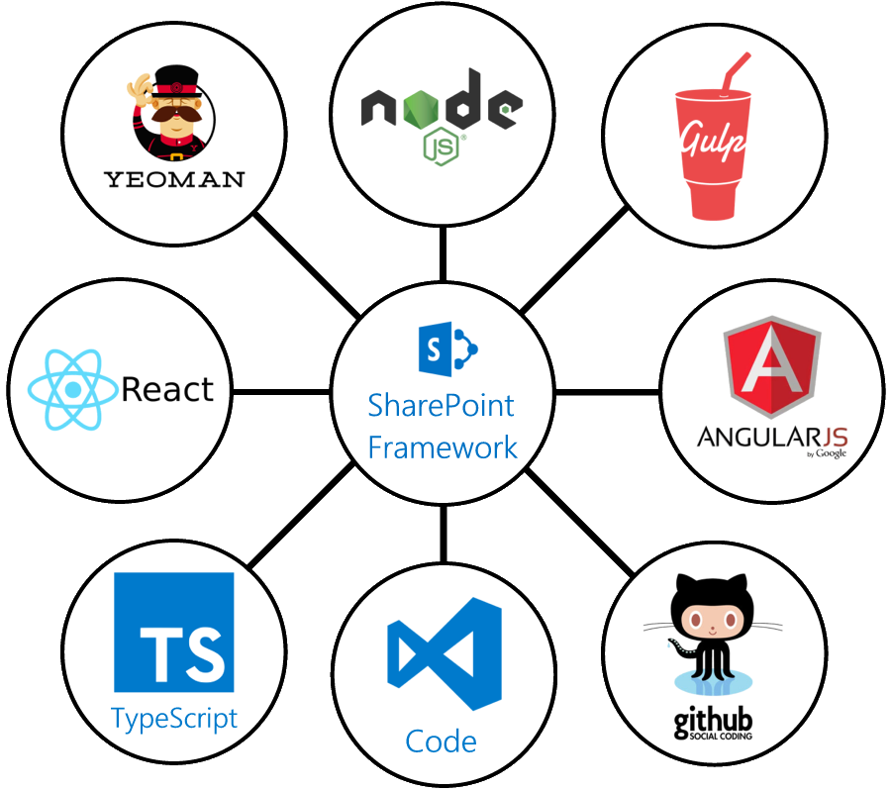
New Development Workflow
Microsoft is embracing the open source community by allowing developers to use any JavaScript framework they prefer.
The “local development” model is very different – Gulp and node.js are used to host files locally, so you don’t need to use IIS on your local machine. A special “workbench.aspx” page is used to support this.
You should consider learning TypeScript

Slide 12
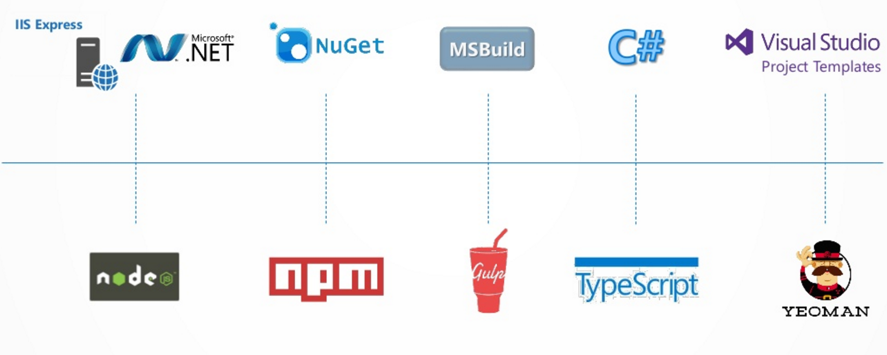
Toolchain Comparison

Slide 13
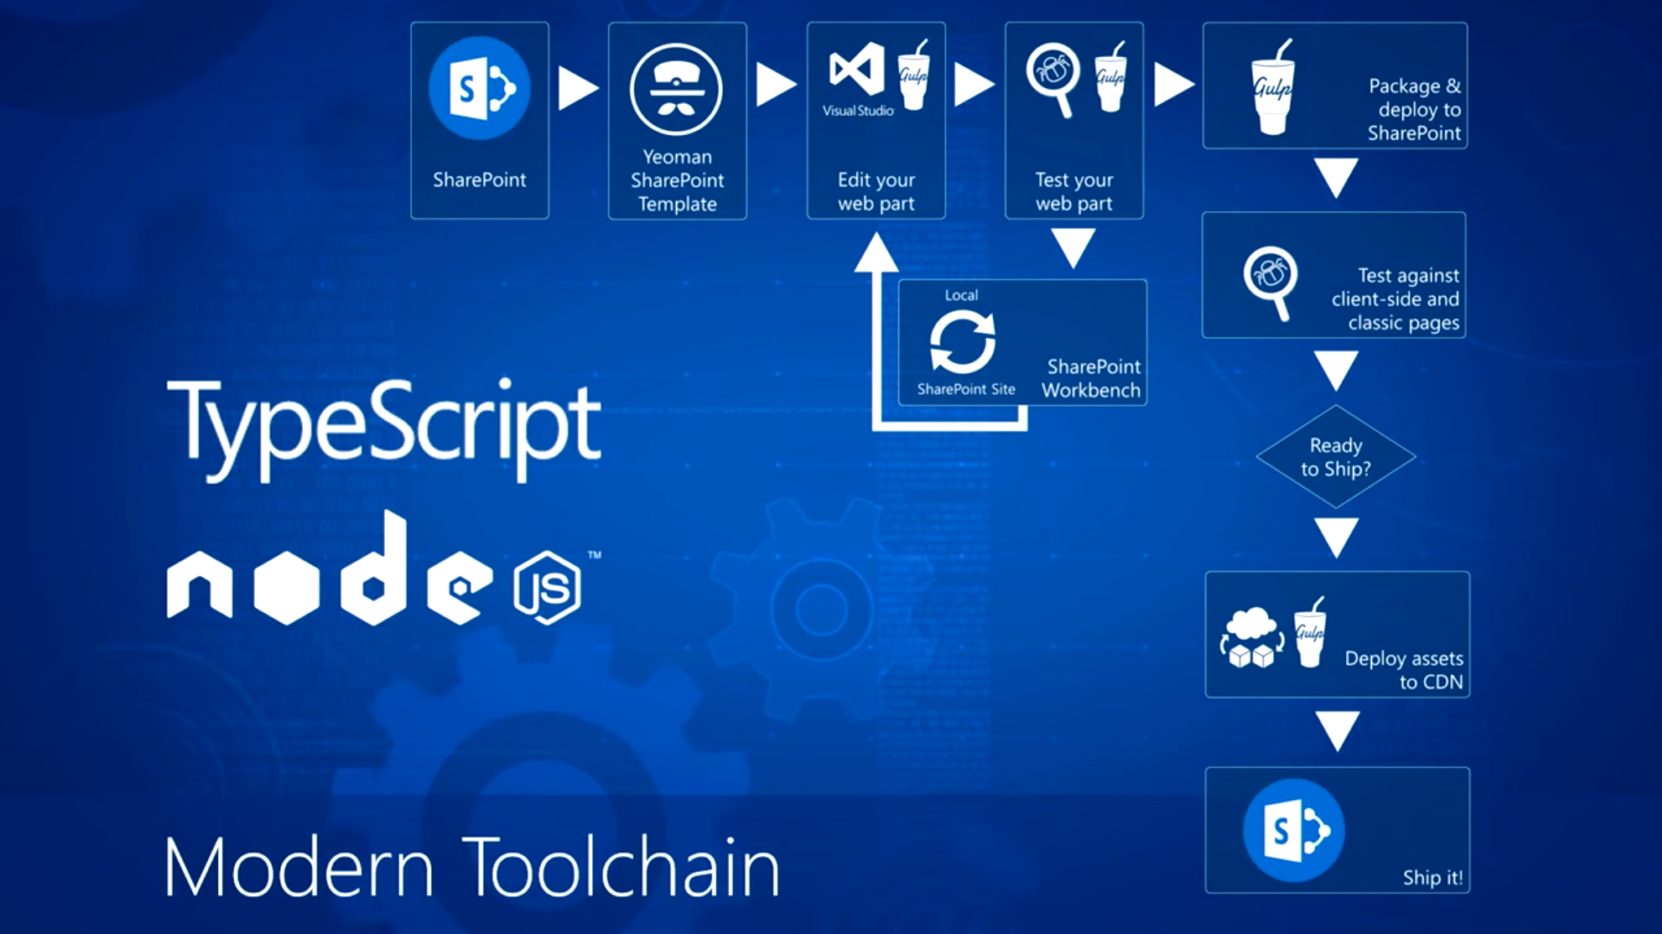
Modern Toolchain

Slide 14
SharePoint Workbench
Is a developer design surface that enables you to quickly preview and test web parts without deploying them in SharePoint.
Works locally and helps you quickly test and validate solutions you are building.
It is also hosted in your tenancy. You can access it from your tenancy on the following URL:
https://your-sharepoint-site/_layouts/workbench.aspx

Slide 15
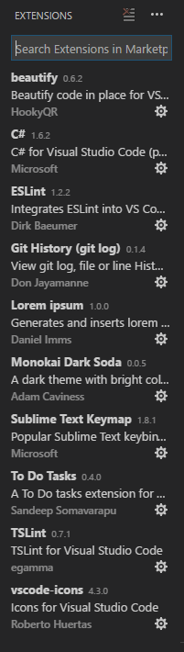
Set up Dev Environment
Recommended VSCode extensión:
Set up your Office 365 Tenant
Install VSCode https://code.visualstudio.com/
Install NodeJs https://nodejs.org/en/
Run in command prompt (Admin Rights):
npm install -g npm@3
npm install -g --production windows-build-tools
npm install -g yo gulp
npm install -g @microsoft/generator-sharepoint
npm install -g typescript

Slide 16
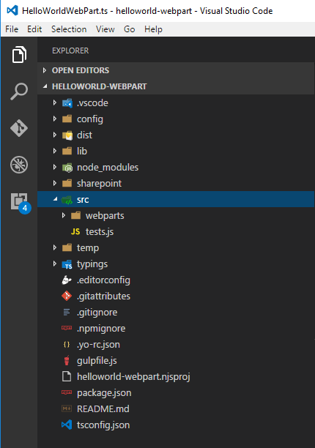
Solution Folder Structure
Folder | Purpose
config | Settings for bundling/deployment
dist | Final code files which are distributed with your application
lib | Processed code files which are ready to move into the bundle
node_ modules | JS modules used by the solution
sharepoint | spapp file that you’ll add to the App Catalog
src | Where you write code
typings | TypeScript typings

Slide 17
Demo

Slide 18
Demo Steps
On command go to folder location:
cd “PATH”
md “webpartName”
cd “webpartName”
In the project folder run the SharePoint Framework Yeoman generator to scaffold a new SharePoint Framework project.
yo @microsoft/sharepoint
When prompted, enter corresponding values.
Gulp commands
To preview build
gulp serve
To deploy package
gulp bundle –ship
gulp package-solution --ship

Slide 19
Caveats
SPFx is still WIP, you might find outdated/missing documentation.
Errors when naming CSS classes using dash "-"
Bundle vs CDN

Slide 20
References
https://blog.mastykarz.nl/when-use-sharepoint-framework/
http://www.sharepointnutsandbolts.com/2016/05/the-new-sharepoint-development-model.html
http://www.paitgroup.com/converting-your-cewp-customizations-to-the-sharepoint-framework/
https://www.concurrency.com/blog/december-2016/introducing-the-sharepoint-framework-(spfx)
https://dev.office.com/sharepoint/docs/spfx/set-up-your-development-environment
https://dev.office.com/sharepoint/docs/spfx/web-parts/guidance/build-custom-property-pane-controls
http://www.sharepointnutsandbolts.com/2016/09/sharepoint-framework-web-part-properties-pages-groups-controls.html
Chris O'Brien - Modern SharePoint sites and the SharePoint Framework – reference
https://github.com/OlivierCC/sp-client-custom-fields
https://github.com/SharePoint/sp-dev-docs/wiki/Working-with-the-Logging-API
https://github.com/OlivierCC/spfx-40-fantastics

